Slide 1
Ammonium Nitrate
Fire Code Regulations Update
Martin Gresho, PE
Fire Protection Engineer
FP2FIRE
Notes:
Who am I?
FPE consultant.
Couple of engineering degrees then Fire Protection
Normally go where I get paid – not this. This has a different motivation.
Code development. NFPA 2 Hydrogen, NFPA 55 Gases, NFPA 400 HazMat
Filling a void for code warriors.
West TX happened, 10 Firefighters, 2 civilian responders and 3 civilians dead.
FireFighter on rural Volunteer FD.
Why am I here?
The last two combine for 1) It matters to me and could have been me (at West or the next West) and 2) I am in a position to make a difference.
I think the Fire Prevention world let down the firefighters at West TX.

Slide 2
Ammonium Nitrate (AN) Background
NH₄NO₃
Nitric Acid + Ammonia
Evaporation Process yields AN
AN is usually a white crystalline solid
Two primary uses:
  Fertilizer - Excellent and inexpensive source of N2
  Excellent and safe explosive
Notes:
AN is a compound containing nitrogen, hydrogen, and oxygen.
To produce combine nitric acid with ammonia then evaporate.
The solid left is AN. Oversimplification
Usually a white crystalline solid. Can be brown or tan or blue as well.
Two major uses
Fertilizer – source of AN. Cheaper than other fertilizers
Explosive – Safer than dynamite to manufacture, transport and store. Not as easy to get an explosion. Still 60% of TNT yield.
Largely replaced the use of dynamite for mining and excavation blasting.

Slide 3
HazMat – 5 Easy Steps
1 Categorize it
2 How much?
3 < Permit Quantity?
4 > Permit Quantity but < MAQ
5> MAQ
Notes:
1. Categorize it Physical or Health hazard. Per fire code. More than 1 category ? Follow both. See next slide.
2 How much? And form and use
3 < Permit Quantity? Not much applies. Most jurisdiction won’t get too involved.
4 > Permit Quantity but < MAQ General requirements. 704 placards kick in.
5> MAQ All general requirements + hazard specific requirements.

Slide 4
AN Hazards
Physical Hazards (2009 IFC §2701.2.2.1)
1. Explosives and blasting agents.
2. Combustible liquids .
3. Flammable solids, liquids and gases.
4. Organic peroxide solids or liquids.
5. Oxidizer, solids or liquids.
6. Oxidizing gases.
7. Pyrophoric solids, liquids or gases.
8. Unstable (reactive) solids, liquids or gases.
9. Water-reactive materials solids or liquids.
10. Cryogenic fluids
Established
Established
???????
Notes:
1. Explosives and blasting agents. (AN can be an explosive but not under NFPA 400) Probably OK. Well established. Not the subject of this talk
2. Combustible liquids .
3. Flammable solids, liquids and gases.
4. Organic peroxide solids or liquids.
5. Oxidizer, solids or liquids. (AN has long been treated as an oxidizer – not much controversy here but Class 2 or 3????)
6. Oxidizing gases.
7. Pyrophoric solids, liquids or gases.
8. Unstable (reactive) solids, liquids or gases. (AN displays unstable reactive properties – particularly UR3 detonable)
9. Water-reactive materials solids or liquids.
10. Cryogenic fluids
AN does not pose significant health hazards – not discussed further.

Slide 5
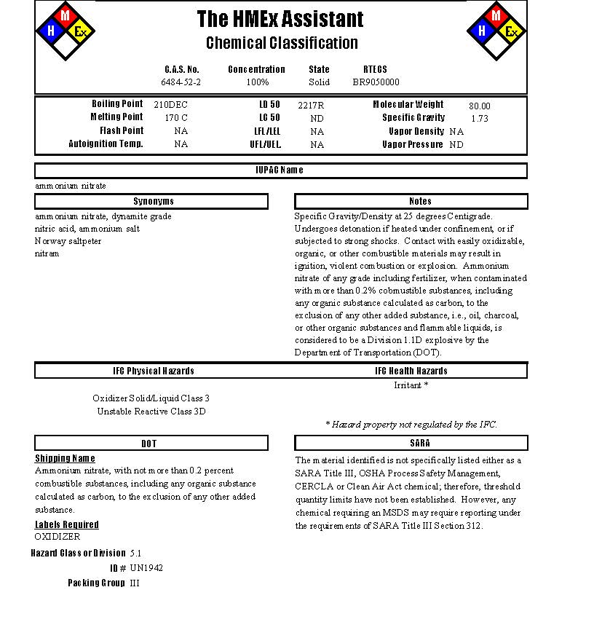
Notes:
This is how HMEX classifies Ammonium Nitrate

Slide 6
Material Category Definitions (IFC)
Oxidizer
OXIDIZER. A material that readily yields oxygen or other oxidizing gas, or that readily reacts to promote or initiate combustion of combustible materials and, if heated or contaminated, can result in vigorous self-sustained decomposition.
Class 4. An oxidizer that can undergo an explosive reaction due to contamination or exposure to thermal or physical shock and that causes a severe increase in the burning rate of combustible materials with which it comes into contact. Additionally, the oxidizer causes a severe increase in the burning rate and can cause spontaneous ignition of combustibles.
Class 3. An oxidizer that causes a severe increase in the burning rate of combustible materials with which it comes in contact.
Class 2. An oxidizer that will cause a moderate increase in the burning rate of combustible materials with which it comes in contact.
Class 1. An oxidizer that does not moderately increase the burning rate of combustible materials.
Notes:
AN is likely a class 2 or class 3 oxidizer
Class 4 is the worst.
Not much controversy
Not too hard to meet.
Not the problem
Not the focus of this presentation.
Classes are subjective – NFPA 400 introduced a testing protocol in 2013 (Annex G.1) Still subjective in IFC.
Oxidizers are not combustible but they make things that are burn MUCH worse. Very fast hot fire. This was observed at West.

Slide 7
Unstable Reactive (IFC)
UNSTABLE (REACTIVE) MATERIAL. A material, other than an explosive , which in the pure state or as commercially produced, will vigorously polymerize, decompose, condense or become self-reactive and undergo other violent chemical changes, including explosion, when exposed to heat, friction or shock, or in the absence of an inhibitor, or in the presence of contaminants, or in contact with incompatible materials . Unstable (reactive) materials are subdivided as follows:
Class 4. Materials that in themselves are readily capable of detonation or explosive decomposition or explosive reaction at normal temperatures and pressures . This class includes materials that are sensitive to mechanical or localized thermal shock at normal temperatures and pressures .
Class 3. Materials that in themselves are capable of detonation or of explosive decomposition or explosive reaction but which require a strong initiating source or which must be heated under confinement before initiation. This class includes materials that are sensitive to thermal or mechanical shock at elevated temperatures and pressures.
Class 2. Materials that in themselves are normally unstable and readily undergo violent chemical change but do not detonate. This class includes materials that can undergo chemical change with rapid release of energy at normal temperatures and pressures , and that can undergo violent chemical change at elevated temperatures and pressures.
Class 1. Materials that in themselves are normally stable but which can become unstable at elevated temperatures and pressure.
Notes:
Class 3 has two subcategories – detonable and non-detonable. Makes a difference for Occupancy Classification
H-1 or H-2.
Class 3 – It can detonate but needs a strong initiator (like a exposure fire) maybe one that is made worse by an OXIDIZER.
UR3 det is NOT an explosive.
Most of NFPA TC agrees that much AN can be classified as UR3 detonable. Still draft!
This IS the problem (part of it).

Slide 8
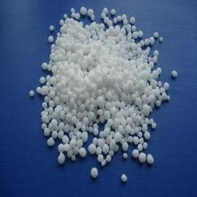
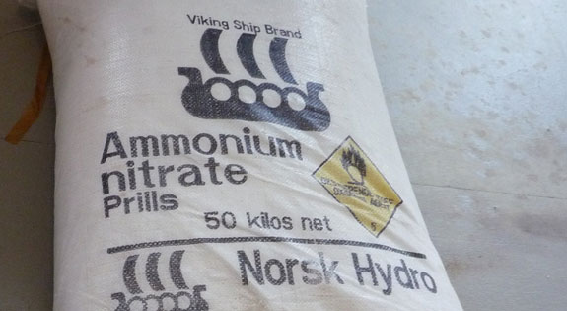
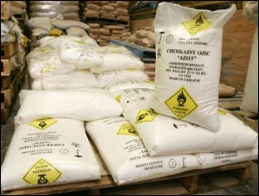
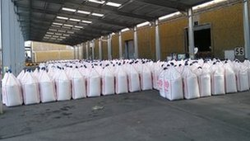
AN Storage Methods - Bags
Notes:
What AN looks like
Bags, super sacks

Slide 9
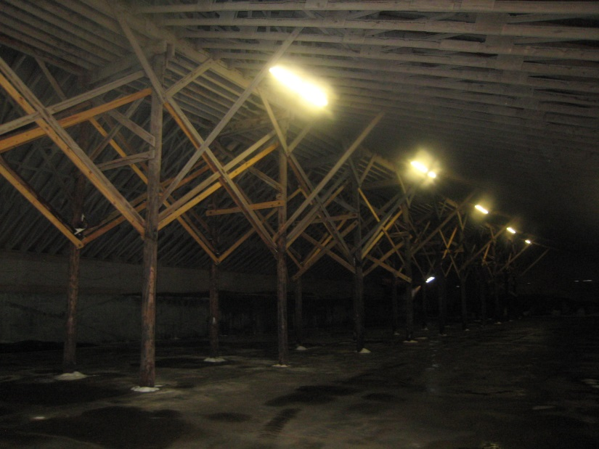
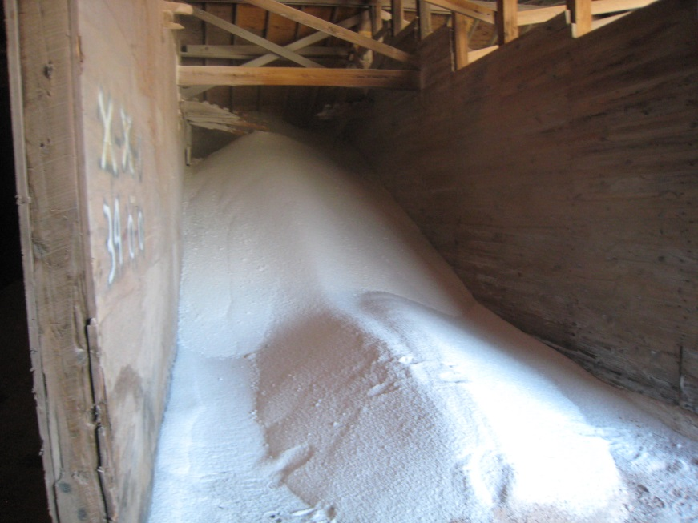
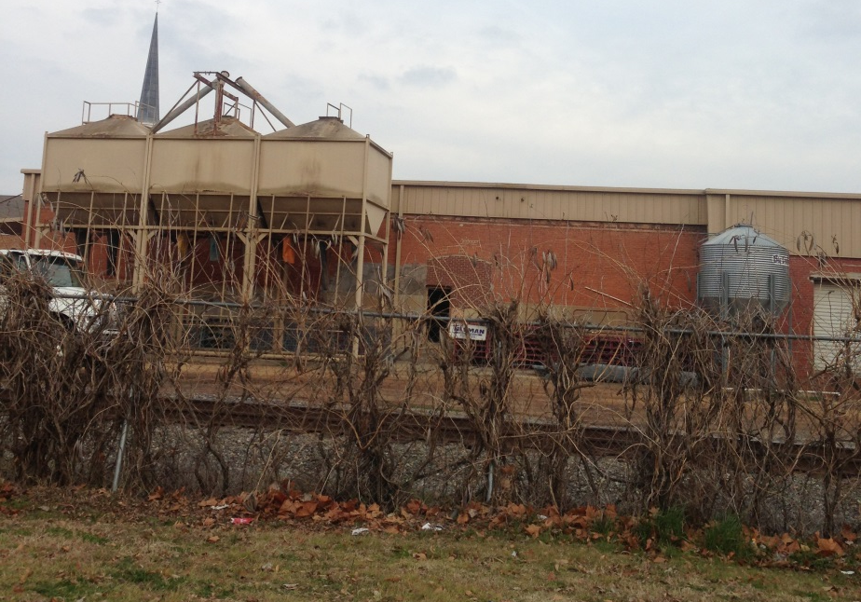
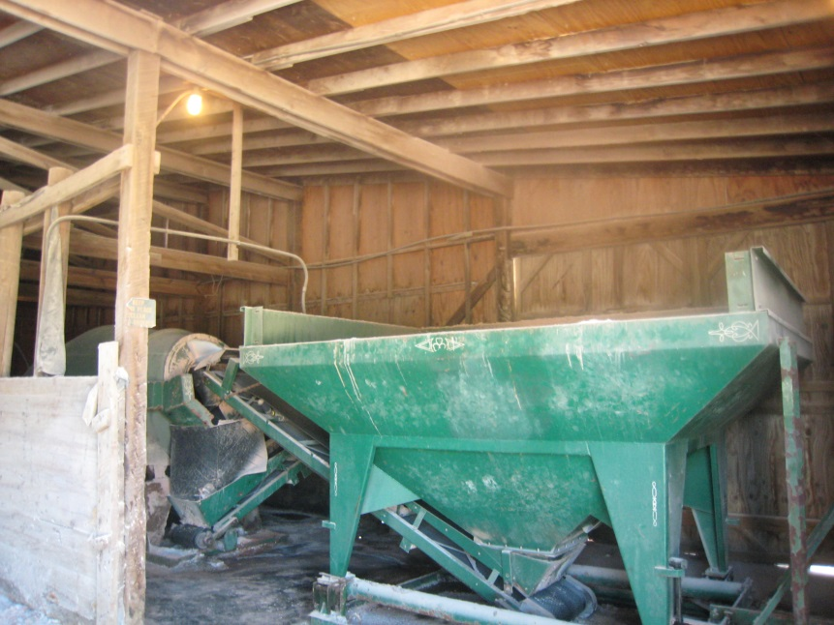
AN Storage Methods – Bulk
Notes:
AN Storage Methods – Bulk – Might also call this solid pile
Note construction type. Type V N or B or non rated structural.
Note if UR3 Detonable then H-1 or PL-1
Type V NR or V-B is not allowed. Minimum is type V – A.
These would likely be existing non complying – meaning they were built not in compliance.
Exterior hoppers – how should these be proteceted.

Slide 10
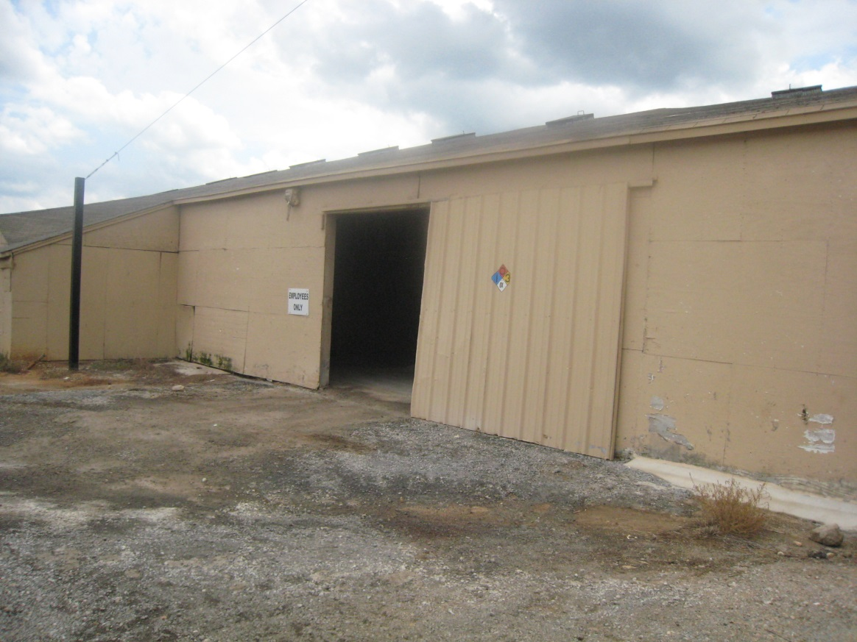
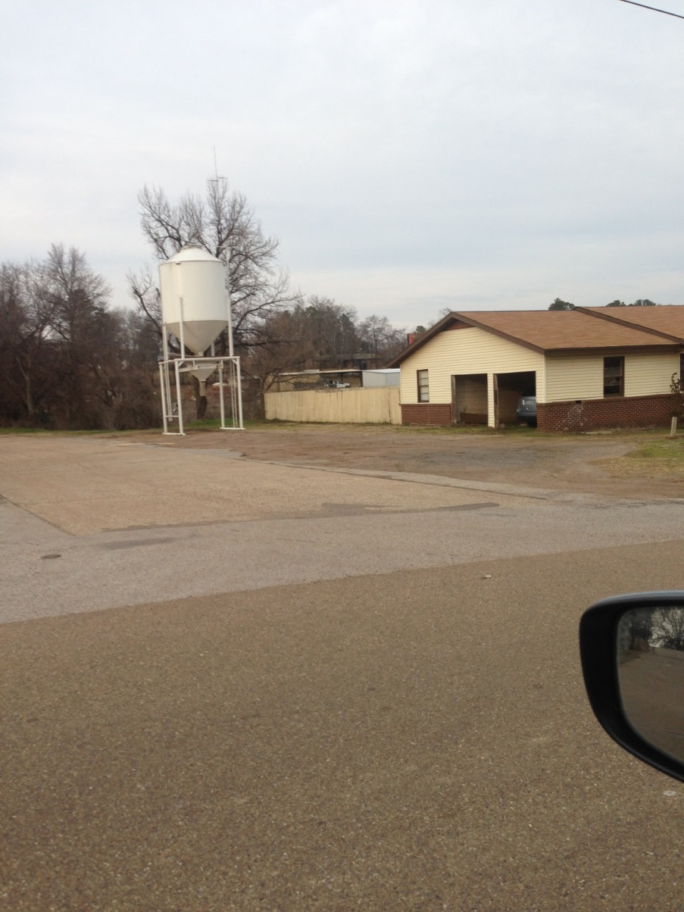
Typical AN Storage Facility
Notes:
Right Image
Typical exterior view.
Existing facility with AN inside.
Note construction type
Note 704 placard 1-0-3-OX Is this enough?
This is what responders would see.
1st 20-30 minutes will appear as a normal combustibles fire. Or an oxidizer enhanced fire – then it could detonate.
Left Image
Appears to be residential
Exterior hopper.

Slide 11
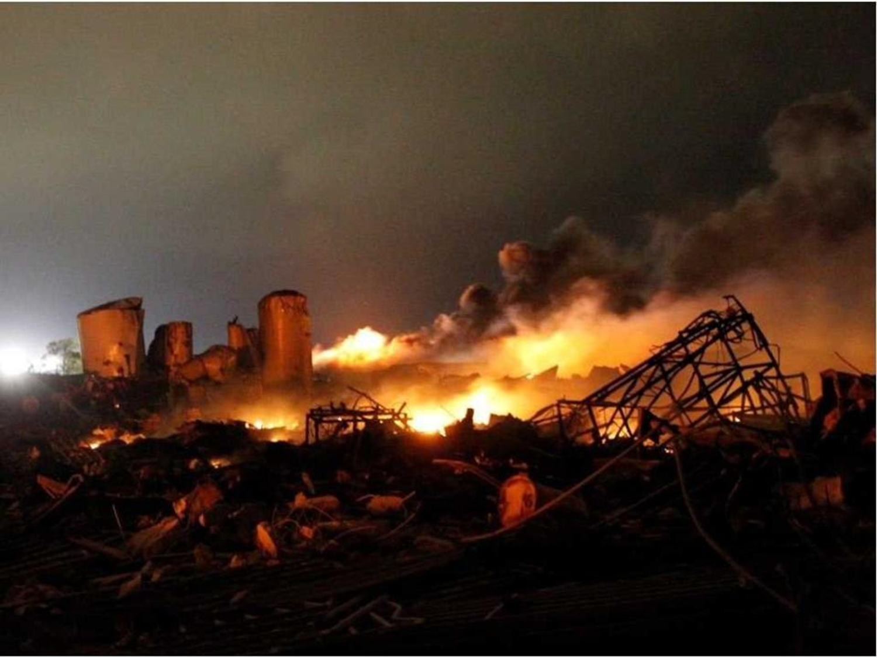
West, Texas Incident - Overview
Review of Loss History
Investigations are ongoing
Notes:
Fun part??? In a twisted way.
Think about
Is this an Oxidizer?
Is this an Explosive?
Is this UR?
Just what is this stuff??

Slide 12
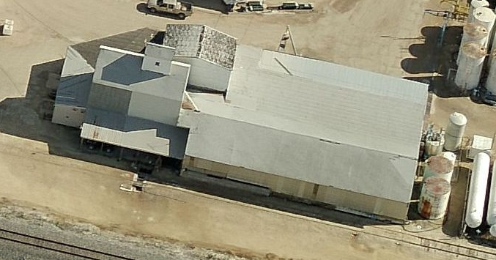
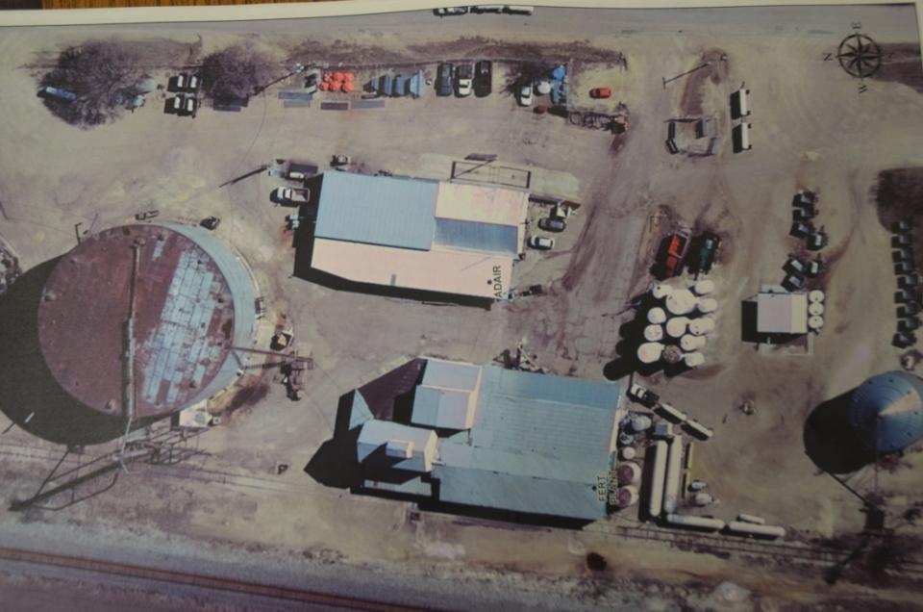
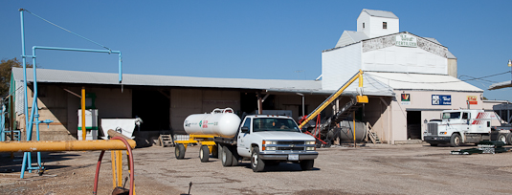
West TX, Before
Notes:
Elevated AN hopper used to make blends
FD response? Where would you park? What would you be thinking? Water supply???

Slide 13
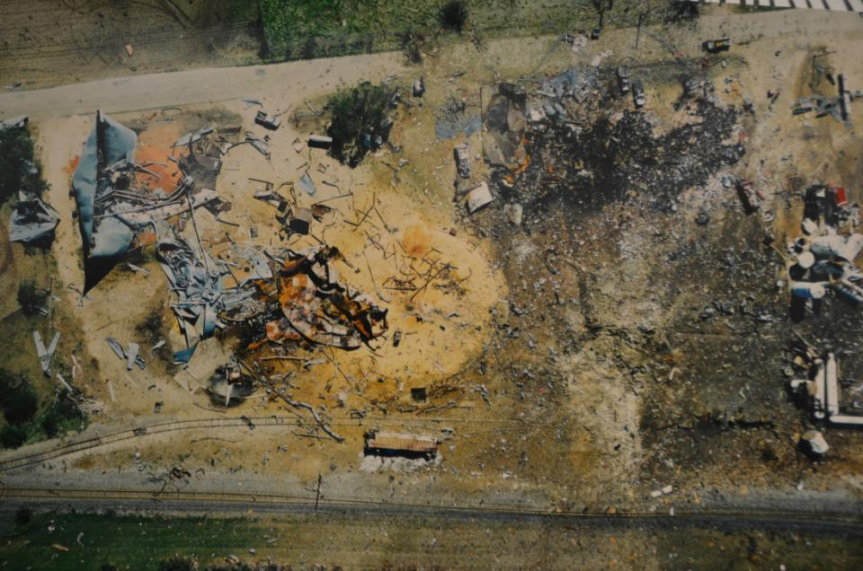
West TX - After
Notes:
Oxidizer?
Explosive?
Unstable Reactive?

Slide 14
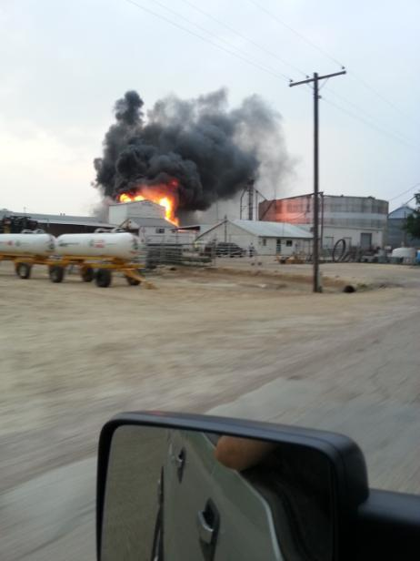
West, TX – On Arrival?
Notes:
~7:30 PM – Photo by passerby
What if the middle of the day (school)? Or night (apartments)?
Time to split?
Rule of thumb?
You have no knowledge of what is inside. No pre plan. No evacuation plan.
What do you do? Fight as ordinary combustible fire?
Look at ERG?? Would it help? Only if you knew what was inside.
This is what I would expect a fire involving ordinary combustibles and oxidizers to look like. Hot and Fast!

Slide 15
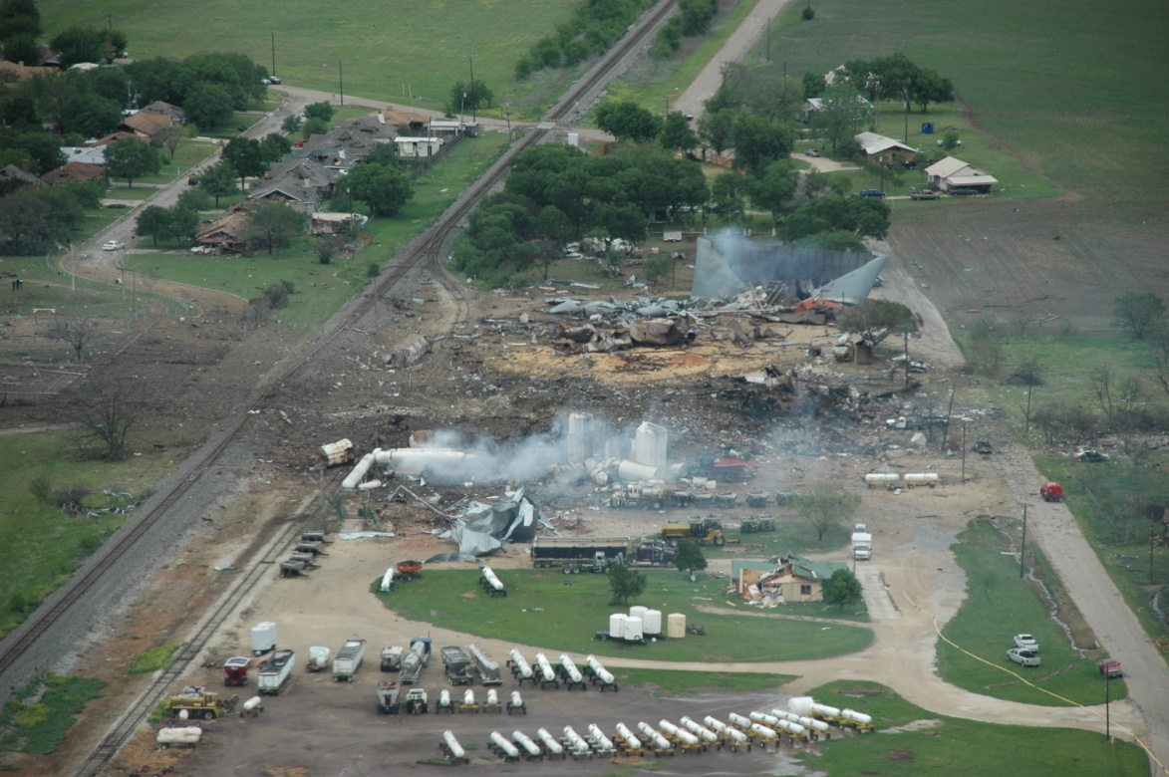
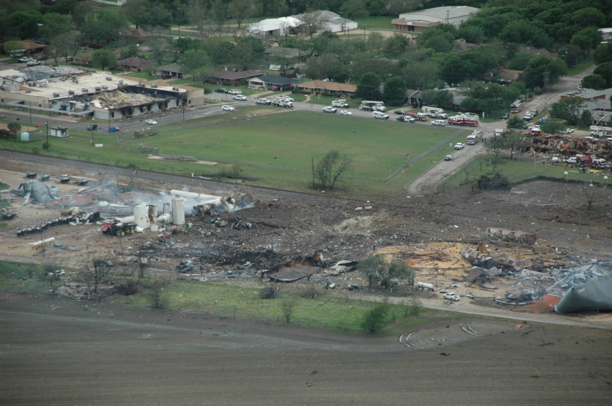
West, TX After
Notes:
Looks like a blast wave?

Slide 16
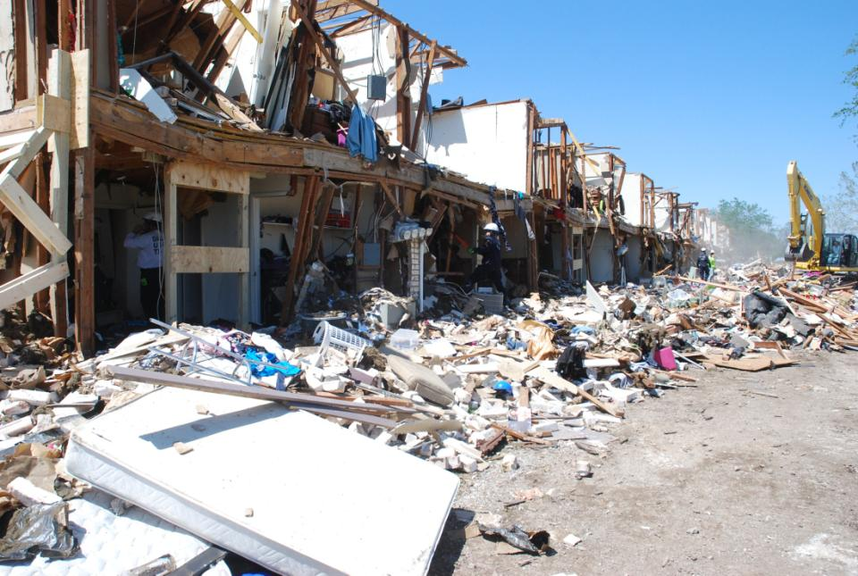
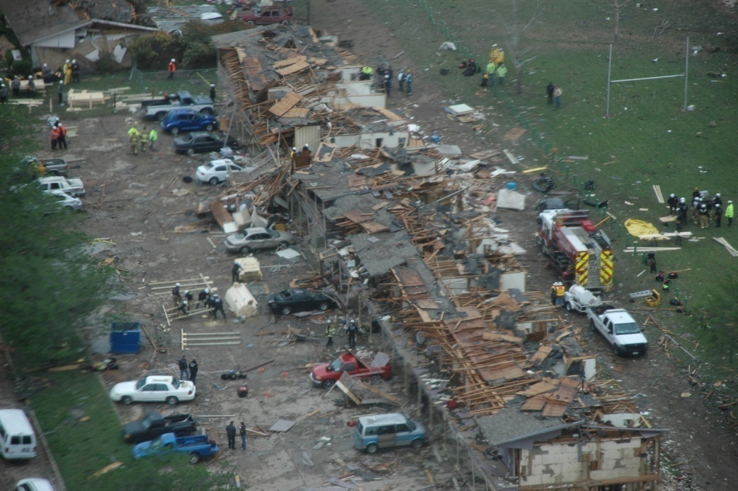
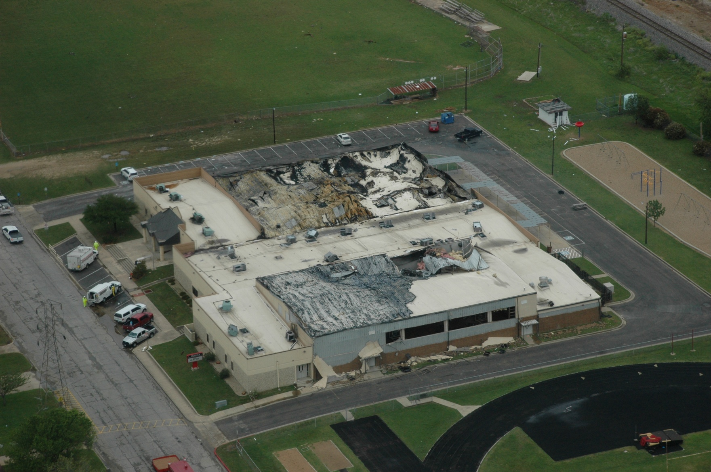
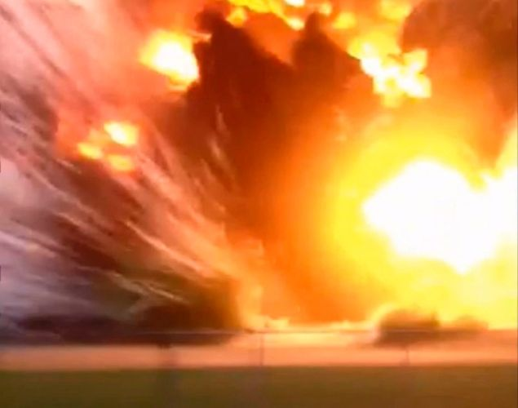
West, TX - After
Notes:
Photos from Google.

Slide 17
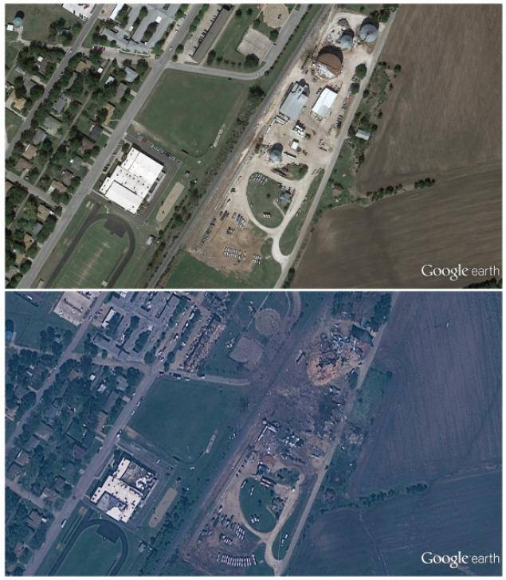
West, TX Before- After (from space)
Notes:
Not the best image but you can see this from space!

Slide 18
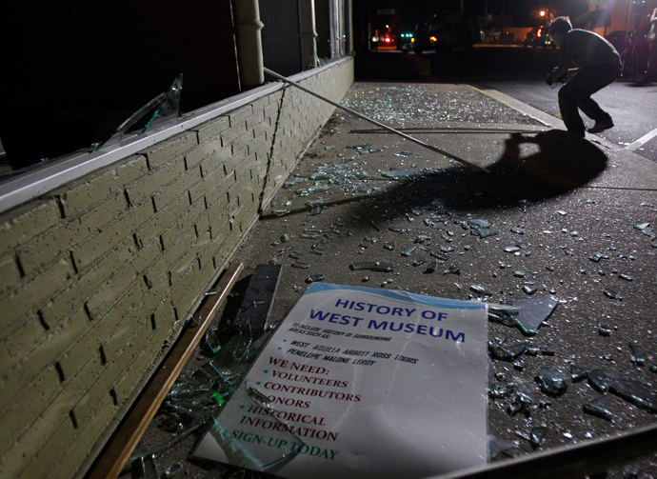
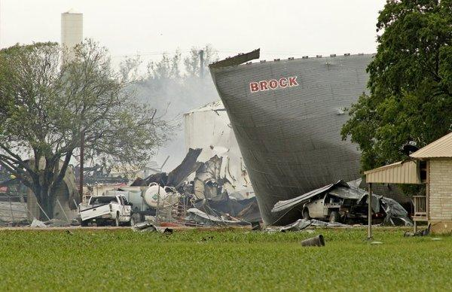
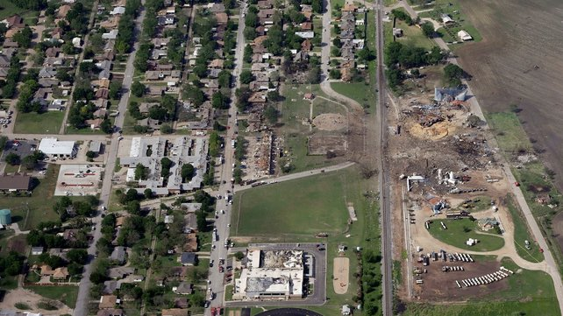
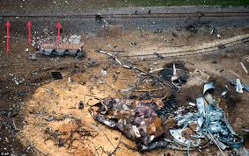
West, TX - After
Notes:
Above Left – Museum may need to add to the history list.
Below left – Note school in lower left
Above right – Tank damage. What was in this?
Lower right – Note blast wave moved the railroad rails.
What happens to a person nearby? Grisly. Not like the movies.

Slide 19
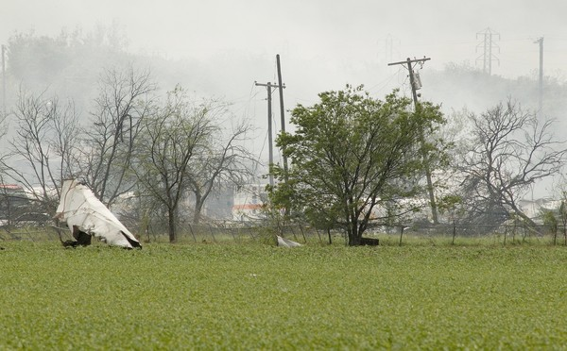
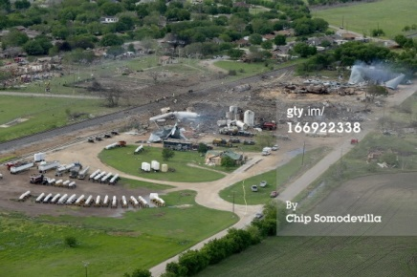
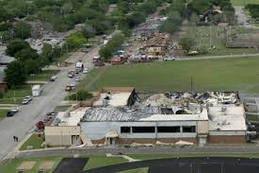
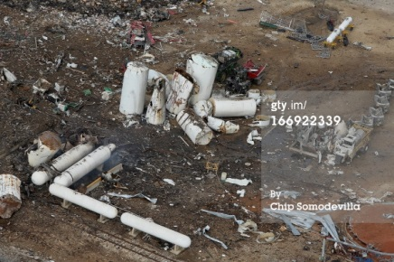
West, TX - After
Notes:
Upper left – flying shrapnel? Do oxidizers do this?
Lower left – birds eye view
Upper right –
Lower right - School

Slide 20
Has AN Exploded before?
Notes:
This HAS happened before.
From Wikipedia so may not ne 100% right…..but unlikely to be 100% wrong.

Slide 21
Has AN Exploded Before?

Slide 24
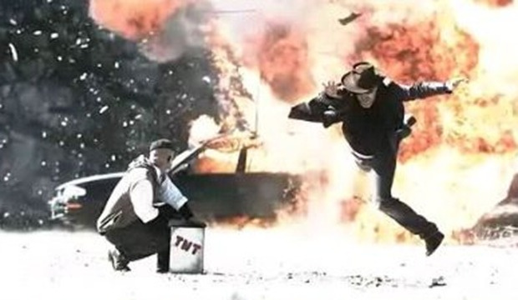
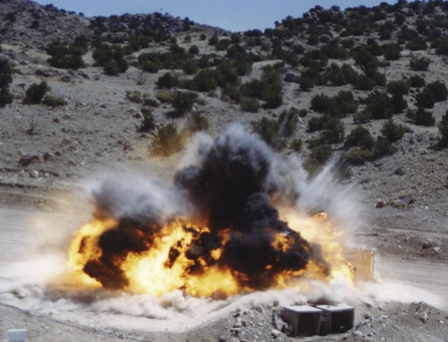
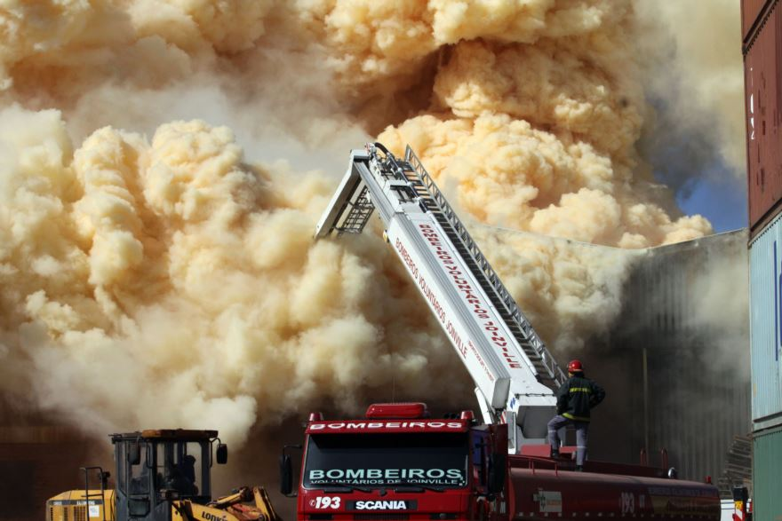

AN Explosion Images – Not WEST
Notes:
Not WEST
Upper left – Rocket scientists. Mythbusters 500 lbs AN
Lower left – NO EXPLOSION! Brazil 2013. Monitor nozzle! Way to go!! Three cheers.
Upper right – New Mexico Test ANFO
Lower right – Toluose France

Slide 25
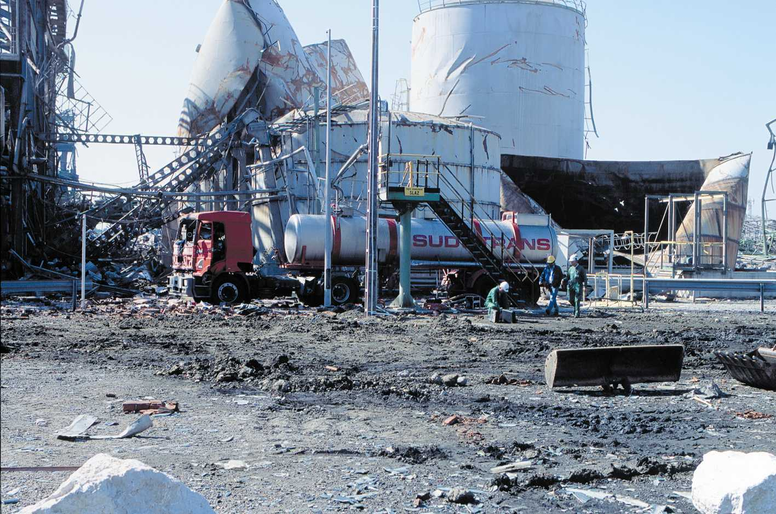
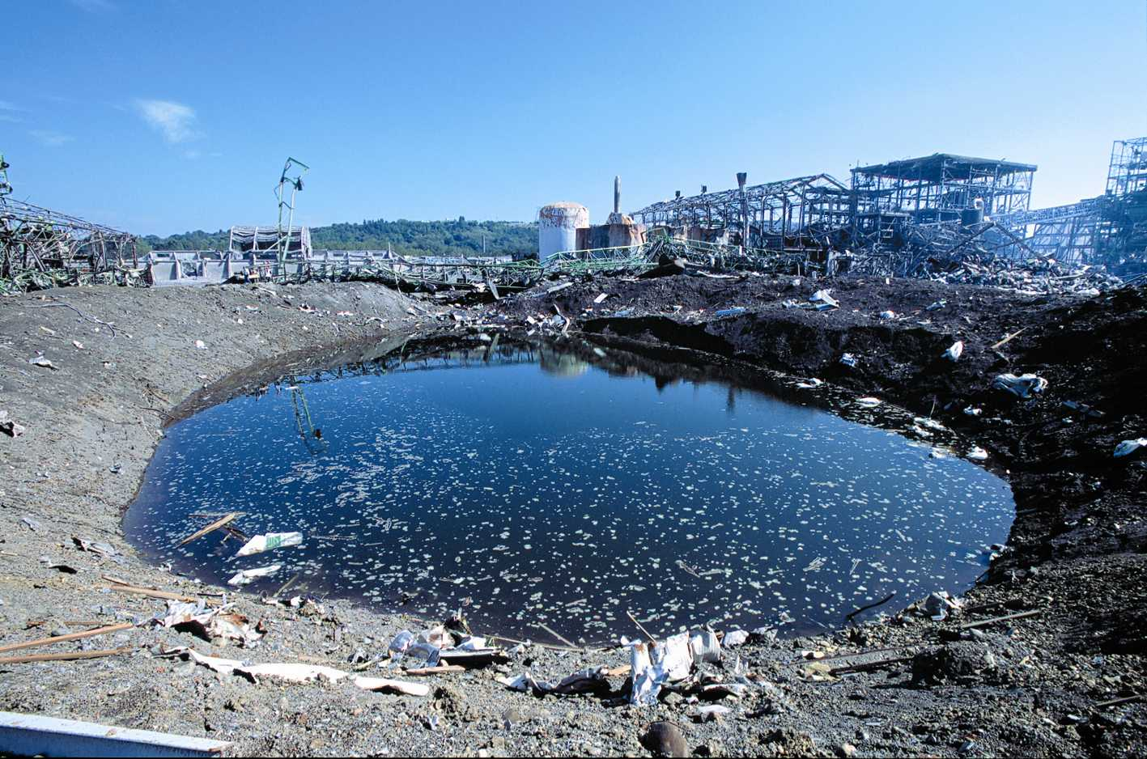
Notes:
Both photos – Toluose France

Slide 26
Code Requirements - NOW
2009 IFC
  §3301.1.5 AN shall be per NFPA 490
  5 step process does NOT apply.
  Note: 490 (2002 last edition) has been replaced with NFPA 400 (2013 most recent).
2012 IFC
  §5601.1.5 AN shall be per NFPA 490 (2002) and Ch 63 (oxidizers).
For IFC states – No clear pointer to NFPA 400
Notes:
2009 IFC
§3301.1.5 (explosives and fireworks chapter) AN shall be per NFPA 490. STOPS HERE. Does not get to 400.
Note: 490 (2002 last edition) has been replaced with NFPA 400 (2013 most recent)
2012 IFC
§5601.1.5 AN shall be per NFPA 490 (2002) and Ch 63. Oxidizers.
For IFC states – No clear pointer to NFPA 400. There needs to be.

Slide 27
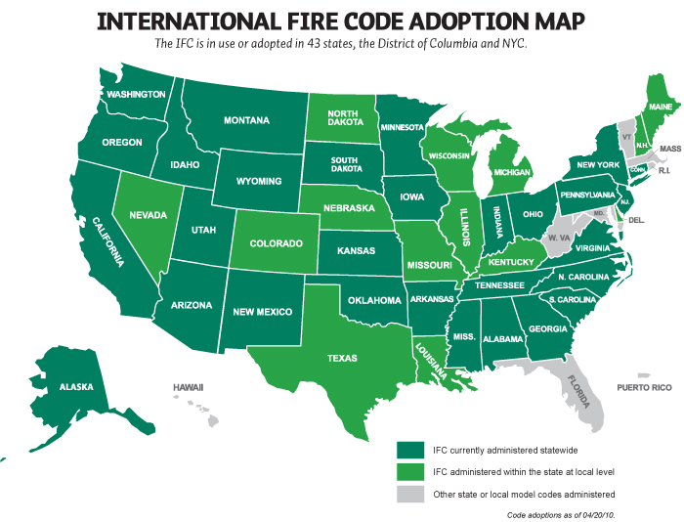

Slide 28
Code Requirements - NOW
NFPA 1
  2013 edition added Ch 74 Ammonium Nitrate
  Invokes 2010 Edition of NFPA 400
  5 step process DOES apply.
  Updates to 2013 Edition with 2016 Edition (staff function)
  NFPA 400 currently working on 2015 Edition

Slide 29
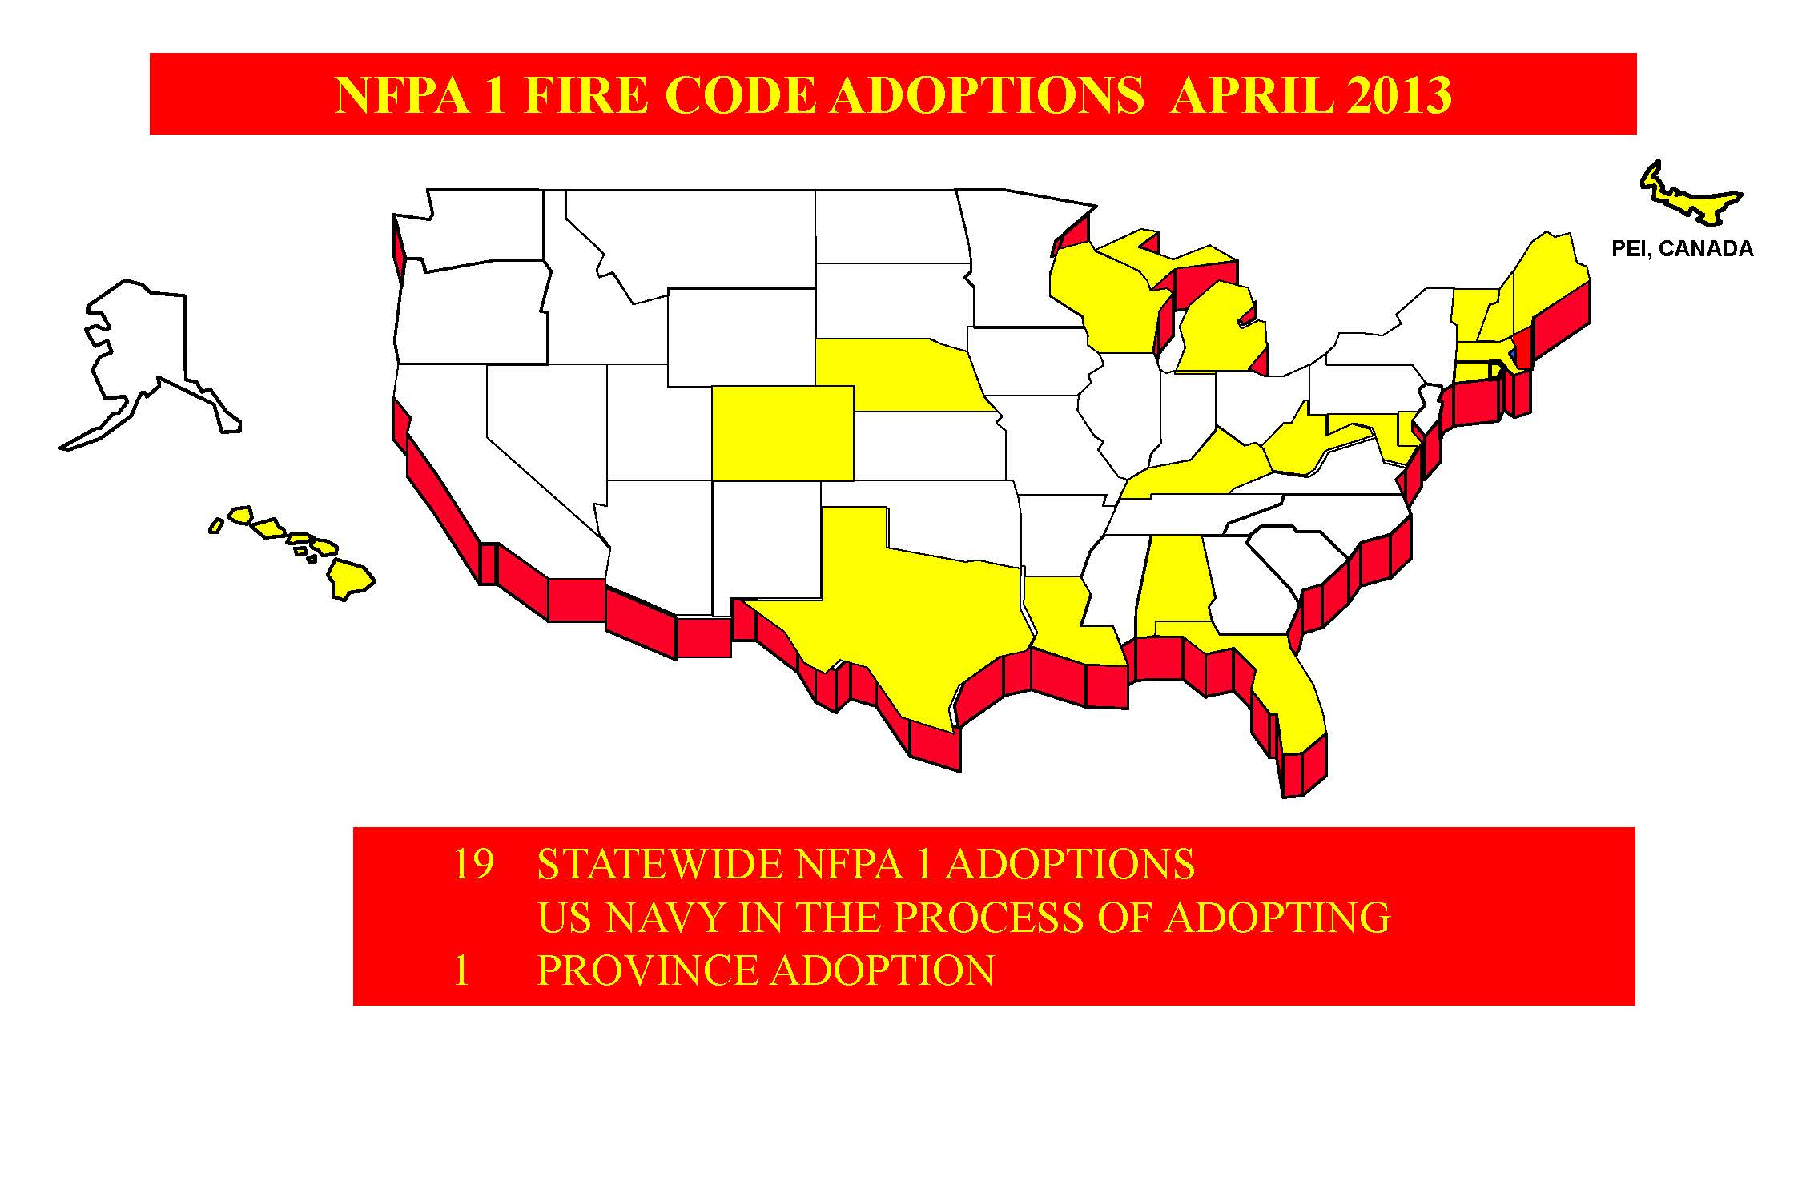
Notes:
61 states total? Which country is this???

Slide 30
NFPA 400 – 2013 How to Apply
AN is Treated Different from all other Hazardous Material
Material Specific Chapter
Not a Hazard Specific Chapter
Notes:
Chapter 11 came from fitting 490 into 400 ch 11. Not a perfect fit. Getting better.

Slide 31
Classify AN per Ch 4
Determine MAQ per Table 5.2.1.13
<MAQ
Apply Ch 1-4
+
Applicable requirements of
Ch 5-10
>MAQ
Apply Ch 1-4
+
Applicable requirements of Ch 5-10
+
Chapter 11
None of Oxidizer or UR Chapters

Slide 32
NFPA 400 Ch 11 AN (2013)
Applies >MAQ (5 lbs for UR3 det)
Existing Conflicts that need improvement
  Applicability >MAQ or % ammonium nitrate (annex E)
  Sprinkler requirement. >MAQ per 11.2.6 or >2500 tons in bags per 11.2.6.1.1.
  AHJ decisions or prescriptive requirements?
  Outdoor storage? Nearly no requirements 11.4
Notes:
Discuss why UR3 det matters

Slide 33
NFPA 400 Proposed Changes
Delete conflicting thresholds
Require sprinklers retroactively
Require fire alarm retroactively.
  Flow switch
  Building notification
Require Evacuation Plan and community siren if >1000 lbs and UR3 det.
Heat detection for outdoor hoppers
Notes:
Marty proposals. Still lots of hoops to jump through.

Slide 34
NFPA 400 Timing
Changes (If approved) 2016 Edition.
  Changes will meet resistance.
  Paradigm shift
  Similar comments will help.
IFC 2018?
Municipal Codes some years after that?
Is this schedule acceptable?

Slide 35
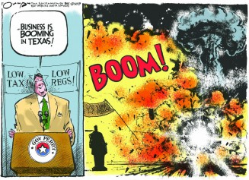
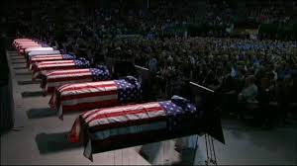
Conclusions
Notes:
Cartoon about TX. BUT – Is your jurisdiction in better shape?
I see the poor fire code adopting structure and the poor code content as contributors to the coffins in West, TX.
We need to do better.

Slide 36
Conclusions
Is your jurisdiction in good shape?
  Clear code adopted?
  HazMat program in all jurisdictions?
  Clear path forward for existing-non-complying structures?
Codes need improvement
  IFC – Improve reference to NFPA 400
  NFPA 400
    Clean up conflicts
    Develop clear retroactive requirements
    Improve notification/emergency planning
    Other?

Slide 37
Conclusions
NFPA 400 Status
  Public comment is welcome
  Committee does not write the code – the public does
  Deadline for input:
    Paper: 4/11/2014
    Electronic: 5/16/2014
Notes:
Where is help needed? NFPA 400 needs input.
Late start.
NFPA 400 Status
Public comment is welcome – I feel like a 1 man show. I need your help!!!!!!
Committee does not write the code – the public does. Strange but true.
Deadline for input:
Paper: 4/11/2014
Electronic: 5/16/2014
Please help me!

Slide 38
Contact Information
Martin Gresho
FP2FIRE phone: 303-642-3547 email: marty@fp2fire.com

